Slide 1
What Makes A Christian Strong?
2 Peter 1:1-11

Slide 2
What Makes A Christian Strong?
It is evident that becoming strong as a Christian is a necessary duty. 1 Peter 2:2; Ephesians 4:14-15; 1 Corinthians 16:13; Ephesians 6:10-17
God wants His children to grow closer in our relationship to Him. cf. James 4:7-8
Strength needed … Overview of 2 Peter.

Slide 3
What God Has Given Us 2 Peter 1:3-4
All things that pertain unto life and godliness. 2 Timothy 3:16-17; cf. 1 Peter 4:11
Through a knowledge of Jesus Christ. cf. Romans 1:16-17; cf. 2 Timothy 1:12; Matthew 11:28-30
“Precious and exceeding great promises.” Acts 2:38-39
“Partakers of the divine nature.” Galatians 2:20

Slide 4
What We Are To Supply 2 Peter 1:5-7
1. FAITH is “conviction, strong assurance”
2. VIRTUE is “moral excellence, goodness”
3. KNOWLEDGE is “correct insight”
4. SELF-CONTROL is “self-discipline”
5. PERSEVERANCE (patience ASV) is “bearing up under trials”
6. GODLINESS is “godly character out of devotion to God”
7. BROTHERLY KINDNESS is “love toward brethren”
8. LOVE is “active goodwill toward those in need”

Slide 5
Give “diligence” (verses 5, 10)
Hebrews 6:11-12; Hebrews 11:6; 2 Peter 3:14; 2 Peter 1:10; 2 Timothy 2:15
Involves 3 things.
a. Personal effort. cf. Romans 14:10-12
b. Constant effort. 1 Corinthians 15:58
c. Enthusiasm / Zeal. Titus 2:14

Slide 6
“Adding on your part …” “Supply” 2 Peter 1:5
“Add to your faith .” The verb rendered ‘add’ (Greek epichoreegeesate) (NT:2023) is derived from choros (NT:5525), a ‘chorus,’ such as was employed in the representation of the Greek tragedies. The verb originally means ‘to bear the expense of a chorus,’ which was done by a person selected by the state, who was obliged to defray all the expenses of training and maintenance.” (Vincent’s Word Studies)

Slide 7
What Is Necessary To Be A STRONG Christian?
Add to your “faith.” FAITH is the foundation of all other spiritual qualities.

Slide 8
Add to your “faith.”
FAITH is the foundation of all other spiritual qualities.
1. What is “faith?” Faith is the firm, unshaken confidence, conviction, or belief in the truth of a proposition, a person, statement, based upon testimony concerning them. cf. Hebrews 11:1, 6
a. It is the “substance” ASV of things hoped for, the “evidence” of things not seen.
b. Faith is that which takes God at His word. Hebrews 11
2. How does “faith” come? Romans 10:17
a. Faith is produced by fact, not false testimony.
b. Contrast Genesis 37:1-35; 45:25f
c. Without faith the other qualities of spiritual maturity are unattainable! 2 Corinthians 5:7
3. Your job now to “be strong!”

Slide 9
Add (supply) to your faith “virtue.”
(Greek arete) “Moral goodness,” excellence. Courage (manliness, 1 Corinthians 16:13) of faith. Used of God’s power. 2 Peter 1:3; cf. Mark 5:30
The moral courage to live your faith, to do what is right!
Positive area of growth to combat the pressures of sin! – cf. John 12:42-43

Slide 10
Add (supply) to your faith “virtue.”
Examples of virtue.
a. Joseph said “NO,” when tempted by Potiphar’s wife. Genesis 39:7-9
b. Daniel. Daniel 1:8; 6:10
c. Shadrach, Meshach, Abednego. Daniel 3:13-18
d. Apostles. Acts 4:19-20; 5:29
e. One Less Carrot.

Slide 11
And in (your) virtue “knowledge”
(Greek gnosis) – moral wisdom, such as is seen in right living, 2 Peter 1:5; Spoken of practical knowledge, discretion, prudence.
We must grow in knowledge. Philippians 1:9-11; Colossians 1:9-10; 2 Peter 3:18; cf. Hosea 4:6; Hebrews 5:12

Slide 12
And in (your) virtue “knowledge”
Areas in which we are to supply knowledge:
Self –
If you don’t know where you are, it is impossible to know where you are going.
One knows himself by looking into the mirror of God’s word. James 1:23-25
God –
To know God is to love Him. 1 John 4:7-8
To know God is to obey Him. 1 John 2:2-3 The Christian who continues in sin does not know God. 1 John 3:6

Slide 13
And in (your) virtue “knowledge”
How does one supply knowledge?
Study! Psalms 119:104; 1:2; 2 Timothy 2:15
Understanding! Ephesians 3:3-4 Required to know when/how to exert moral courage! Ephesians 5:15-17

Slide 14
And in (your) knowledge “self-control”
(Temperance KJV) (Greek engkrateia) – the virtue of one who masters his desires and passions, especially his sensual appetites): Acts 24:25; Galatians 5:22-23 (22); 2 Peter 1:6.
The good athlete must practice self-control. cf. Paul. 1 Corinthians 9:25-27
Needed when we are tempted. James 1:13-15

Slide 15
And in (your) self-control “patience”
(Greek hupomenoo) – is associated with hope (1 Thessalonians 1:3; Romans 8:24-25) and refers to that quality of character which does not allow one to surrender to circumstances or succumb under trial.
Thayer defines it as: (1.) steadfastness, constancy, endurance James 5:11 (2.) a patient, steadfast waiting for; (3.) a patient enduring, sustaining: 2 Corinthians 1:6
cf. Hebrews 10:32-36; Isaiah 40:27ff

Slide 16
And in (your) patience “godliness”
(Greek eusebeia) The word means “reverence, respect piety toward God, godliness: Acts 3:12.” (Thayer)
Godliness is the practical side of religion … it is profitable for all things. 1 Timothy 4:7-8; cf. Ecclesiastes 12:13-14

Slide 17
And in (your) godliness “brotherly kindness”
(Greek philadelphía), one who loves his brother. Brotherly love. In the NT, used of the love of Christians one to another, brotherly love out of a common spiritual life. Romans 12:10; 1 Thessalonians 4:9; Hebrews 13:1; 1 Peter 1:22; 2 Peter 1:7
It is founded upon “sense and emotion” … the kind of love one has for his brother and friend. cf. John 21:15-17
Becomes proof of our love for God. 1 John 4:20-5:1; cf. Galatians 6:1

Slide 18
And in (your) brotherly kindness “love”
(Greek agápe), Love, affectionate regard, goodwill, benevolence.
“Unconquerable benevolence, undefeatable goodwill” (Barclay).

Slide 19
And in (your) brotherly kindness “love”
A deliberate desire (with corresponding action) for the greatest good of its object (Matthew 5:43-48). cf. 1 John 4:7-11; 3:17-18 It is: Caring enough to sacrifice for what is best!
1 Corinthians 13:1-8a, 13 – Love must motivate our actions, define our character and permanently abide in our lives!
Capstone of all other spiritual qualities, love is found in all of them! Matthew 22:37-38

Slide 20
Why Must We Be Strong?
Failure to be strong results in spiritual short-sightedness. 2 Peter 1:8-9; cf. Romans 8:29; Colossians 3:5-11

Slide 21
Why Must We Be Strong?
Being strong means we shall never stumble. 2 Peter 1:10
“to fall into misery, become wretched; cf. the loss of salvation” (Thayer)
But this is true ONLY if we are “giving all diligence” to grow in the knowledge of Christ and thereby “making our calling and election sure.”

Slide 22
Why Must We Be Strong?
Being strong means an entrance into the “everlasting kingdom” will be abundantly supplied. 2 Peter 1:11; cf. 2 Timothy 4:18; cf. 2 Timothy 4:6-8

Slide 23
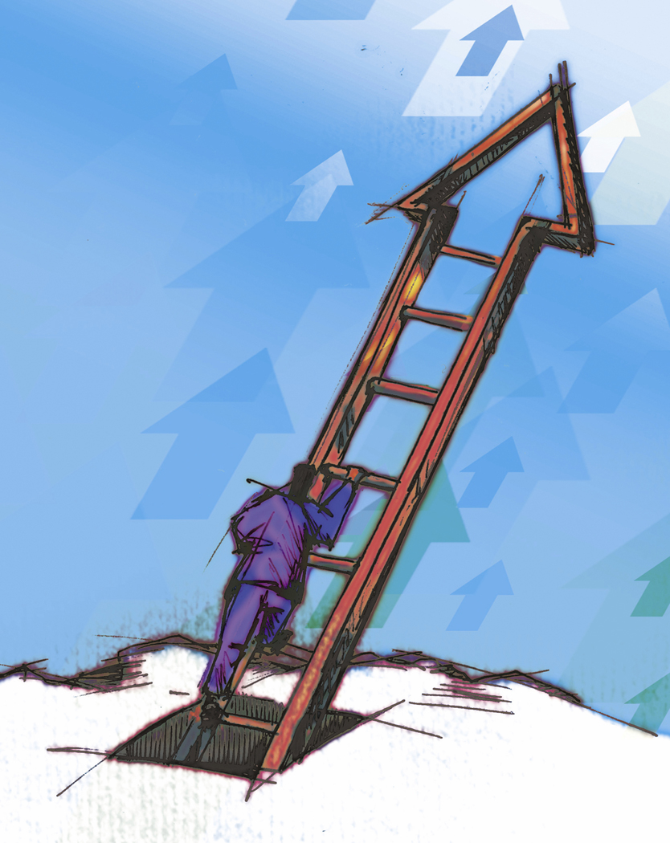
entrance into the “everlasting kingdom”
Love
Brotherly Kindness
Godliness
Patience
Self-Control
Knowledge
FAITH
Virtue
2 Peter 1:5-11

